Slide 1

ADVERSE EFFECTS OF DEPTH ON PHYSIOLOGICAL PERFORMANCE
GROUP 26

Slide 2
OUTLINE
Introduction
Adaptations of deep sea organisms
Physiological changes due to depth
Adverse effects of depth on Physiological performance
Mitigation strategies
Conclusion
References

Slide 3
INTRODUCTION
Depth refers to the distance below the surface of a body of water or the Earth's surface.
Deep-sea diving, high-altitude activities, and space exploration pose unique challenges to human physiology.
Understanding the adverse effects of depth is crucial for safety and optimizing performance in these activities.

Slide 4
ADAPTATIONS OF DEEP SEA ORGANISMS
Physiological activities that best take place at high depths are primarily associated with deep-sea organisms and adaptations that allow them to survive in extreme conditions. Some of these activities include:
Bioluminescence: This is the production and emission of light by a living organism
Slow metabolism
Filter feeding: This is a form of food procurement in which food particles or small organisms are randomly strained from water
Chemotaxis

Slide 5
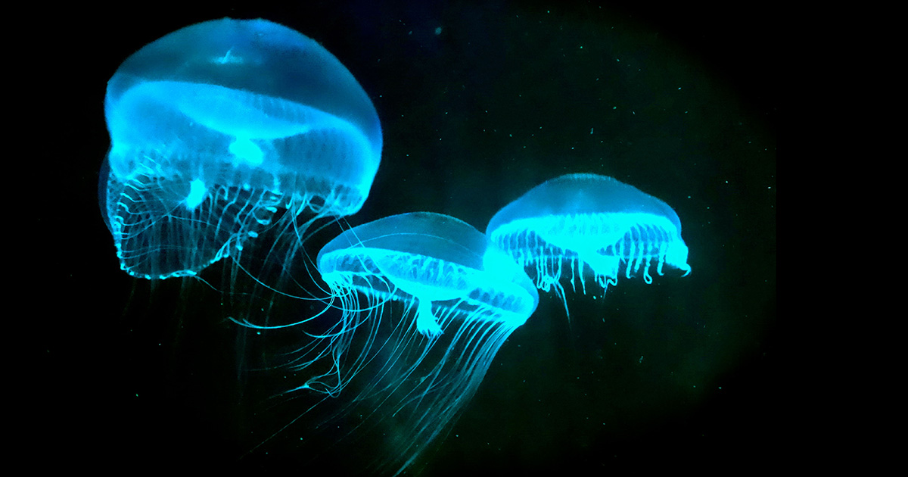
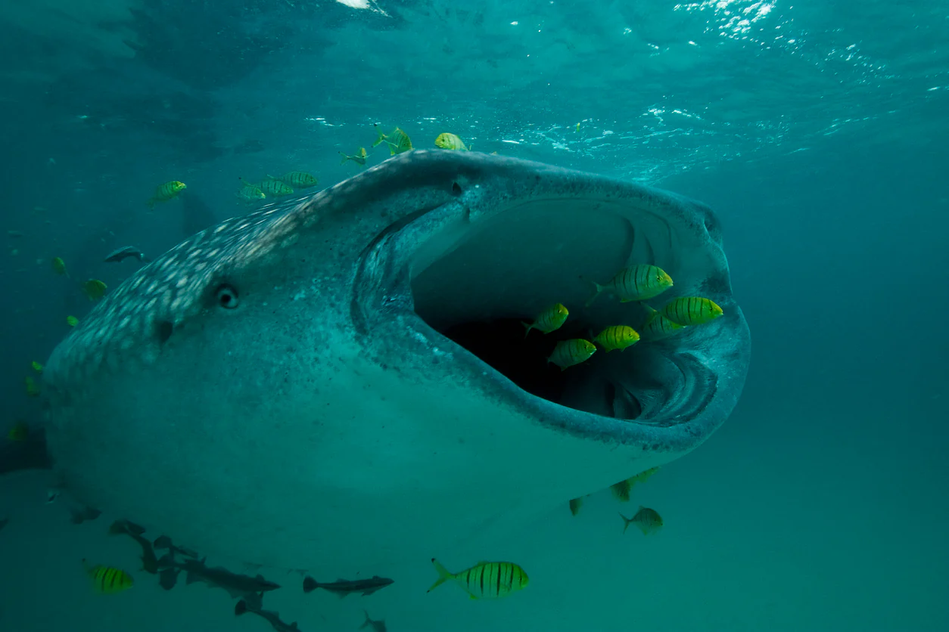
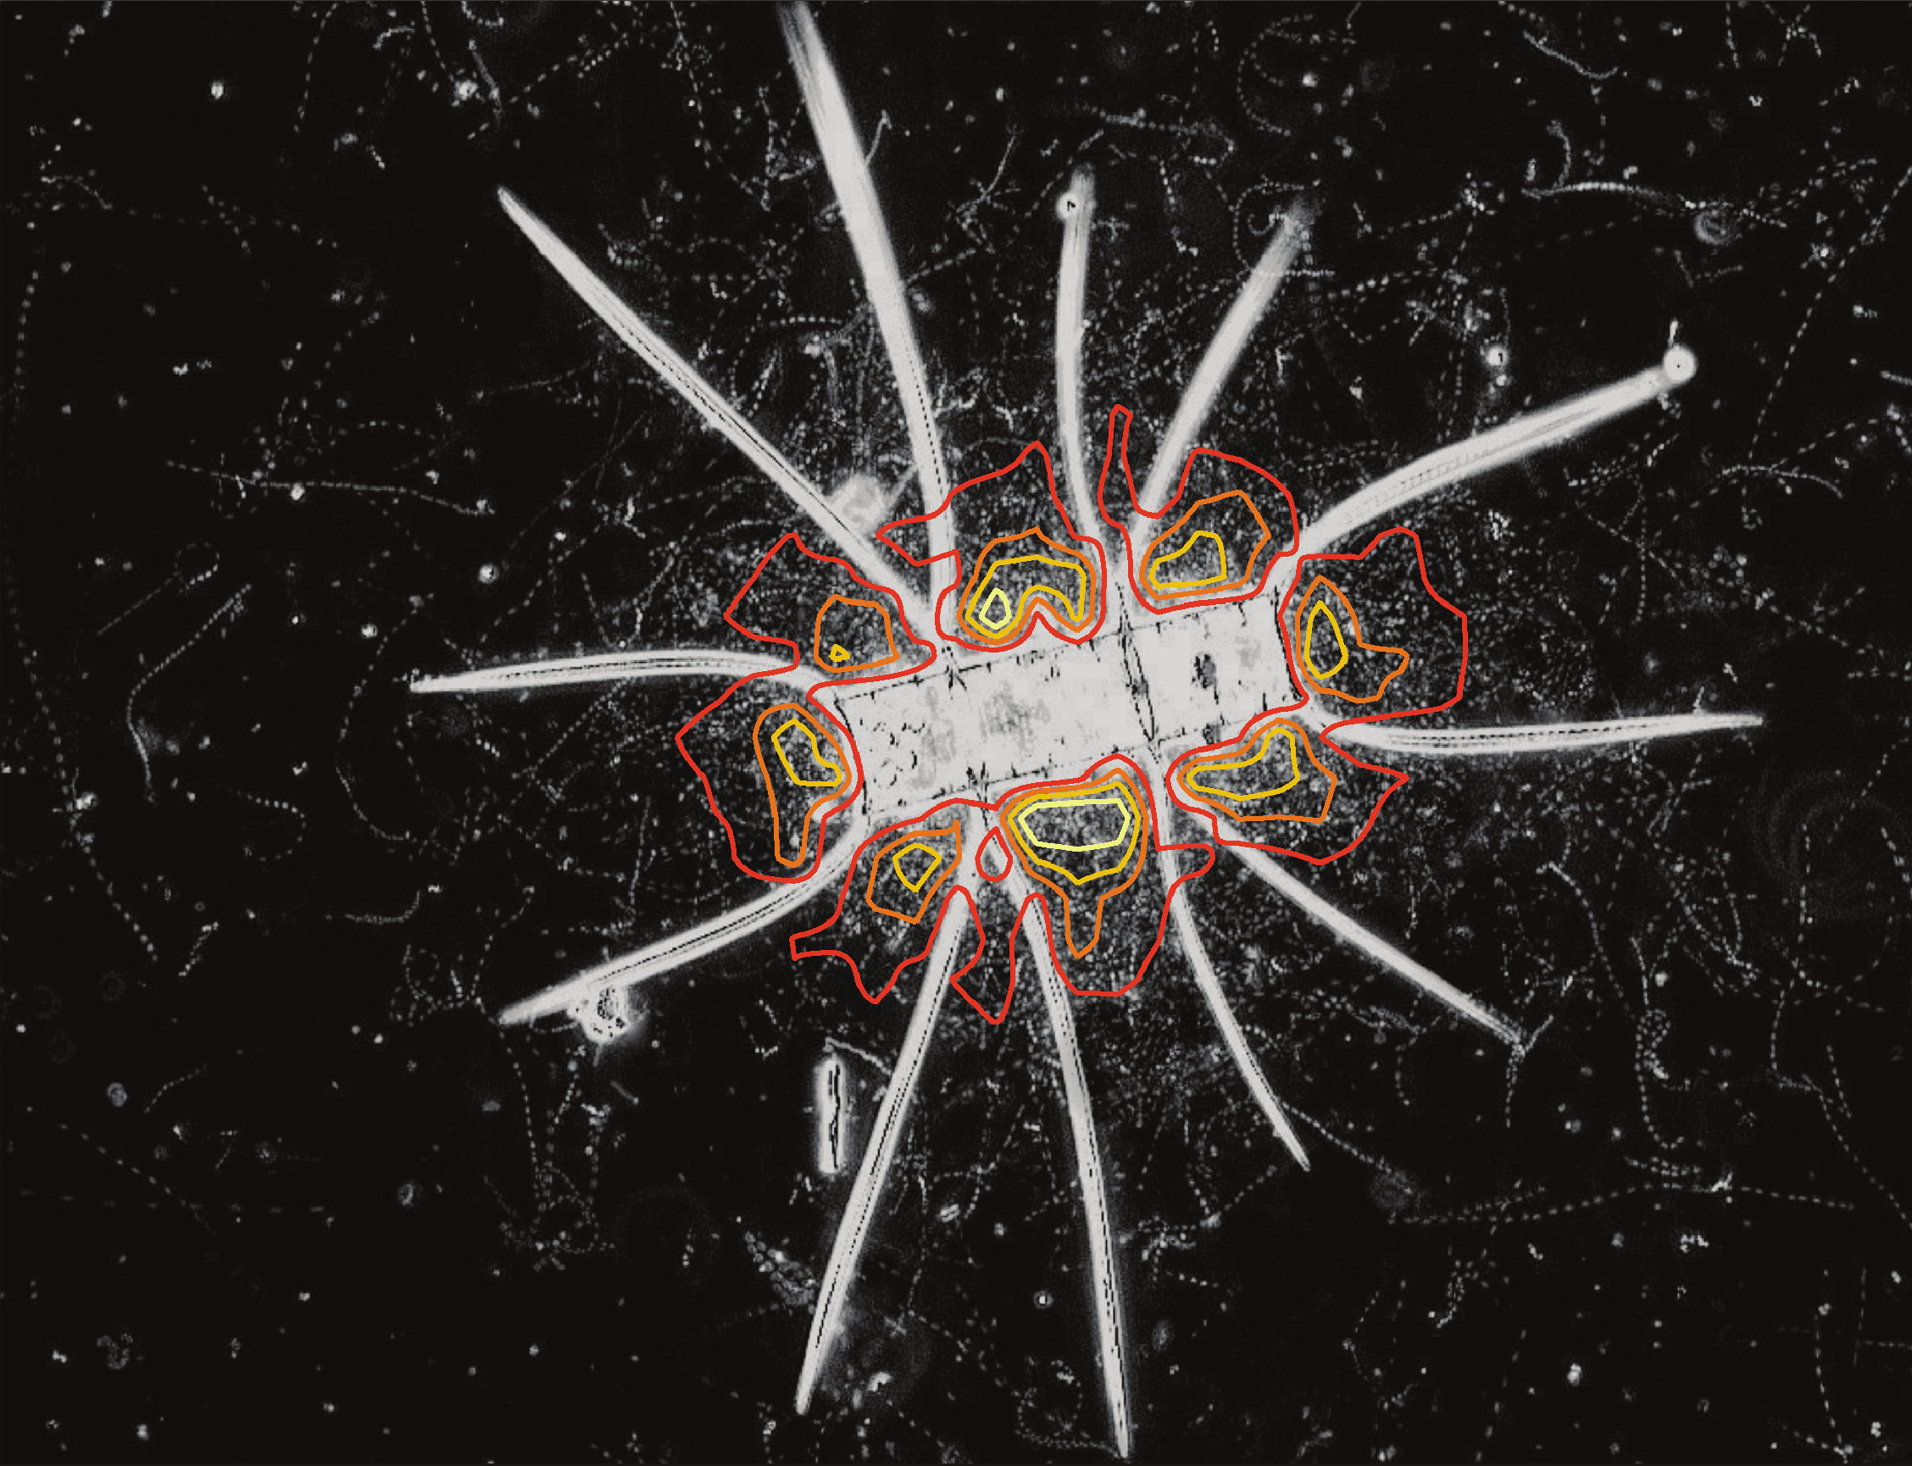
EXAMPLES OF DEEP SEA ORGANISMS
Fig.1 Jelly fish
Fig. 2 Shark
Fig. 3 Bacteria exhibiting chemotaxis

Slide 6
PHYSIOLOGICAL CHANGES DUE TO DEPTH
Nitrogen Narcosis:
Increased nitrogen at depth affects the central nervous system.
Can lead to symptoms similar to alcohol intoxication, impairing judgment and cognitive function.
Decompression Sickness (DCS):
Ascending too quickly after deep dives causes nitrogen bubbles to form in the bloodstream and tissues.
Results in symptoms such as joint pain, neurological issues, and respiratory distress.

Slide 7
ADVERSE EFFECTS OF DEPTH ON PHYSIOLOGICAL PERFORMANCE
Oxygen toxicity
Breathing high levels of oxygen at increased depths can lead to oxygen toxicity.
Damages the central nervous system and pulmonary system, causing convulsions and other complications.
Reduced Lung Volume: Increased pressure reduces the capacity of the lungs.
Altered Blood Flow: Changes in blood distribution due to pressure variations.
Increased Gas Density: Increased density of gases at depth affects gas exchange in the lungs.

Slide 8
MITIGATION STRATEGIES
Decompression Protocols: Implementing safe ascent protocols to prevent decompression sickness.
Gas Mixtures
Acclimatization
Physiological Training:

Slide 9
CONCLUSION
The adverse effects of depth on physiological performance, as observed in deep diving, and the challenges of high-altitude activities highlight the importance of understanding and preparing for these extreme environments.
Proper training, precautions, and acclimatization are crucial to ensuring the safety and well-being of individuals engaged in such activities. By being aware of the potential risks and taking necessary measures, we can enjoy these pursuits while minimizing health hazards and maximizing the experience of exploring these unique environments.

Slide 10
REFERENCES
Lundgren, C., & Miller, J. N. (2016). The Physiology and Medicine of Diving, 5th Edition. CRC Press.
Hamilton, R. W., & Thalmann, E. D. (Eds.). (2004). Diving and subaquatic medicine. Butterworth-Heinemann.
Brubakk, A. O., & Neuman, T. S. (Eds.). (2003). Bennett and Elliott's physiology and medicine of diving. Saunders Ltd

Slide 11
THANK YOU!

